Slide 1
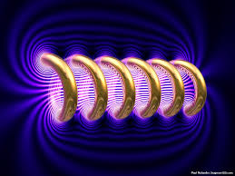
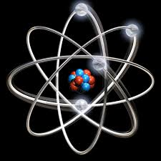

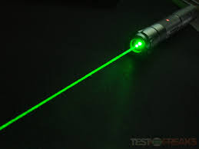


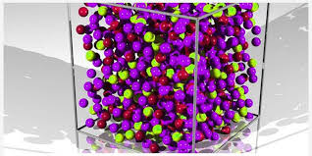
Engineering Physics
PHY-110
Quantum Mechanics
ELECTROMAGNETIC THEORY
QUANTUM MECHANICS
LASER
WAVES
Dr. Vishal Thakur
Department of Physics
Lovely Professional University
Phagwara, Punjab-144411
SOLID STATE PHYSICS
FIBER OPTICS

Slide 2
Syllabus
Need of quantum mechanics, photoelectric effect, concept of de Broglie matter waves, wavelength of matter waves in different forms.
Heisenberg uncertainty principle, concept of phase velocity and group velocity (qualitative),
Wave function and its significance, Schrodinger time dependent and independent equation
Particle in a box

Slide 3
“The discovery of quantum mechanics was nearly a total surprise. It described the physical world in a way that was fundamentally new. It seemed to many of us a miracle.”
Eugene Wigner
Notes:
The fundamental difference between classical (or Newtonian) mechanics and quantum mechanics lies in what they describe. In classical mechanics, the future history of a particle is completely determined by its initial position and momentum together with the forces that act upon it. In the everyday world these quantities can all be determined well enough for the predictions of Newtonian mechanics to agree with what we find.
Quantum mechanics also arrives at relationships between observable quantities, but the uncertainty principle suggests that the nature of an observable quantity is different in the atomic realm. Cause and effect are still related in quantum mechanics, but what they concern needs careful interpretation. In quantum mechanics the kind of certainty about the future characteristic of classical mechanics is impossible because the initial state of a particle cannot be established with sufficient accuracy. As we saw in Sec. 3.7, the more we know about the position of a particle now, the less we know about its momentum and hence about its position later.
The quantities whose relationships quantum mechanics explores are probabilities. Instead of asserting, for example, that the radius of the electron’s orbit in a groundstate hydrogen atom is always exactly 5.3 1011 m, as the Bohr theory does, quantum mechanics states that this is the most probable radius. In a suitable experiment most trials will yield a different value, either larger or smaller, but the value most likely to be found will be 0.53 angstrom.

Slide 4
Need of Quantum Mechanics
At the end of the nineteenth century, physics consisted essentially of classical mechanics, the theory of electromagnetism, and thermodynamics.
Classical mechanics: describes the dynamics of material bodies.
Electromagnetism: study of electricity, magnetism and optics
Thermodynamics: explains the interactions between matter and radiation.
In the beginning of the twentieth century, classical physics was seriously challenged by two major domains:
Relativistic domain: Einstein’s theory of relativity (1905) showed that the validity of Newtonian mechanics fails at speeds comparable to that of light (c = 3×10⁸ m/s).
Microscopic domain: Classical physics fails to explain several phenomena: blackbody radiation, the photoelectric effect, atomic stability, and atomic spectroscopy.
seemed that all known physical phenomena could be explained !
Notes:
The overwhelming success of classical physics—classical mechanics, classical theory of electromagnetism, and thermodynamics—made people believe that the ultimate description of nature had been achieved. It seemed that all known physical phenomena could be explained within the framework of the general theories of matter and radiation.

Slide 5
Timeline
Particle aspect of waves; that is, the concept that waves exhibit particle behavior at the microscopic scale. At this scale, classical physics fails not only quantitatively but even qualitatively and conceptually.
1900: Max Planck introduced the concept of the quantum of energy (energy exchange between an electromagnetic wave of frequency and matter occurs only in integer multiples of hv) and explained the phenomenon of blackbody radiation.
1905: Einstein explained the Photoelectric effect using the concept of photon (light itself is made of discrete bits of energy or tiny particles), which was unsolved since its first experimental observation by Hertz in 1887.
1913: Neil Bohr introduced a model of Hydrogen atom: atoms can be found only in discrete states of energy and the emission or absorption of radiation by atoms takes place only in discrete energy states. This work provided a satisfactory explanation to several outstanding problems such as atomic stability and atomic spectroscopy.
1923: Compton demonstrated corpuscular aspect of light. By scattering X-rays with electrons, he confirmed that the X-ray photons behave like particles.
Dual nature of light
Notes:
. He argued that the, where h is a fundamental constant called Planck’s constant. The quantization of electromagnetic radiation turned out to be an idea with far-reaching consequences. Planck’s idea, which gave an accurate explanation of blackbody radiation, prompted new thinking and triggered an avalanche of new discoveries that yielded solutions to the most outstanding problems of the time.
Right after Rutherford’s experimental discovery of the atomic nucleus in 1911, and combining Rutherford’s atomic model, Planck’s quantum concept, and Einstein’s photons, atoms can be found only in discrete states of energy and that the interaction of atoms with radiation, i.e., the emission or absorption of radiation by atoms, takes place only in discrete amounts of h􀁆 because it results from transitions of the atom between its various discrete energy states. This work provided a satisfactory explanation to several outstanding problems such as atomic stability and atomic spectroscopy.

Slide 6
Wave aspect of light; that is, the concept that waves exhibit particle behavior at the microscopic scale. At this scale, classical physics fails not only quantitatively but even qualitatively and conceptually.
1923: de Broglie postulated that material particles exhibits wave behavior.
1927: Davisson and Germer confirmed de Broglie postulate by showing interference patterns (a property of waves) of electrons (matter).
1925: Heisenberg formulated matrix mechanics to describe atomic structure; expressing dynamical quantities such as energy, position, momentum and angular momentum in terms of matrices, he obtained an eigenvalue problem that describes the dynamics of microscopic systems: foundation of quantum mechanics.
1926: Schrödinger describes the dynamics of microscopic matter by means of a wave mechanics: a generalization of the de Broglie postulate, called the Schrödinger equation. Schrödinger obtained a differential equation: foundation of quantum mechanics.
1927: Max Born proposed his probabilistic interpretation of wave mechanics: he took the square moduli of the wave functions that are solutions to the Schrödinger equation and he interpreted them as probability densities.
Dirac suggested a more general formulation of quantum mechanics which deals with abstract objects such as kets (state vectors), bras, and operators: foundation of quantum mechanics.
Notes:
In addition to providing an accurate reproduction of the existing experimental data, this theory turned out to possess an astonishingly reliable prediction power which enabled it to explore and unravel many uncharted areas of the microphysical world. This new theory had put an end to twenty five years (1900–1925) of patchwork which was dominated by the ideas of Planck and Bohr and which later became known as the old quantum theory.
This new theory had put an end to twenty five years (1900–1925) of patchwork which was dominated by the ideas of Planck and Bohr and which later became known as the old quantum theory.

Slide 7
Photons
Is there any experimental evidence that the photon has zero rest mass?
Alternative theories of the photon include a term that behaves like a mass, and this gives rise to the very advanced idea of a "massive photon". If the rest mass of the photon were non-zero, the theory of quantum electrodynamics would be "in trouble" primarily through loss of gauge invariance, which would make it non-renormalisable; also, charge conservation would no longer be absolutely guaranteed, as it is if photons have zero rest mass. But regardless of what any theory might predict, it is still necessary to check this prediction by doing an experiment.
It is almost certainly impossible to do any experiment that would establish the photon rest mass to be exactly zero. The best we can hope to do is place limits on it. A non-zero rest mass would introduce a small damping factor in the inverse square Coulomb law of electrostatic forces. That means the electrostatic force would be weaker over very large distances.
Likewise, the behavior of static magnetic fields would be modified. An upper limit to the photon mass can be inferred through satellite measurements of planetary magnetic fields. The Charge Composition Explorer spacecraft was used to derive an upper limit of 6 × 10⁻¹⁶ eV with high certainty. This was slightly improved in 1998 by Roderic Lakes in a laboratory experiment that looked for anomalous forces on a Cavendish balance. The new limit is 7 × 10⁻¹⁷ eV. Studies of galactic magnetic fields suggest a much better limit of less than 3 × 10⁻²⁷ eV, but there is some doubt about the validity of this method.
http://www.desy.de/user/projects/Physics/ParticleAndNuclear/photon_mass.html

Slide 8
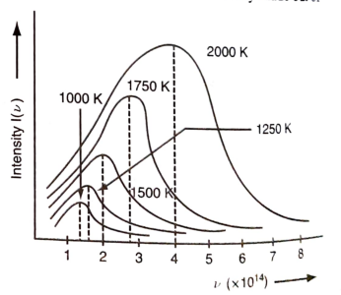
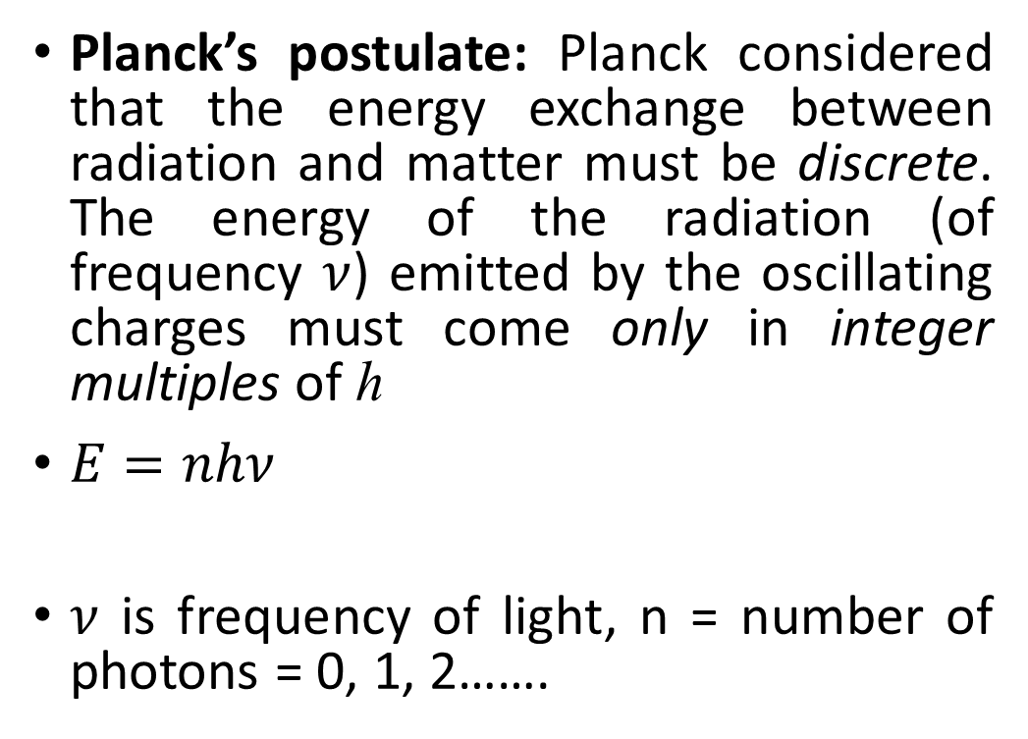
Photon: Quantum of energy
Planck’s postulate: Planck considered that the energy exchange between radiation and matter must be discrete. The energy of the radiation (of frequency $ν$) emitted by the oscillating charges must come only in integer multiples of h
$E=nhν$
$ν$ is frequency of light, n = number of photons = 0, 1, 2…….
Dual nature of light

Slide 9
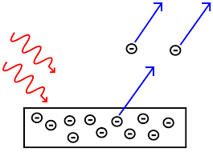
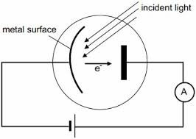
Photo-Electric Effect
The effect refers to the ejection of electrons from a metal surface in response to an incident radiation.
The energy contained in the incident radiation is absorbed by the electrons within the metal gaining sufficient energy to be knocked out of it.
Classical Discrepancy
According to classical Maxwell wave theory, the energy of the electrons should be dependent on the intensity of the incident energy. However, Lenard found that it is not so. Rather, the energy of the emitted electron is almost independent of the incident energy intensity.

Slide 10
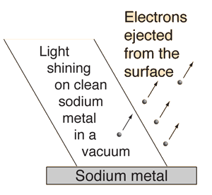
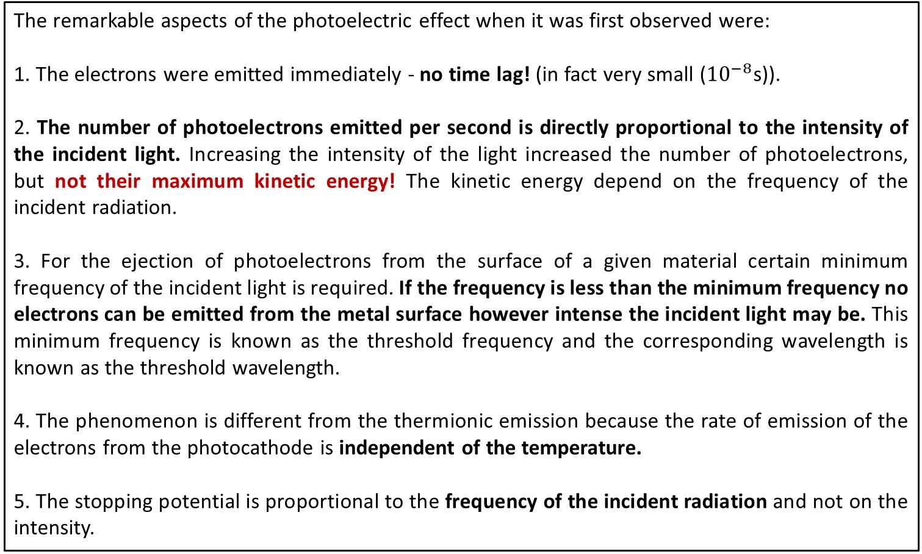
Aspects of Photo-Electric Effect
The remarkable aspects of the photoelectric effect when it was first observed were:
1. The electrons were emitted immediately - no time lag! (in fact very small (${10}^{−8}$s)).
2. The number of photoelectrons emitted per second is directly proportional to the intensity of the incident light. Increasing the intensity of the light increased the number of photoelectrons, but not their maximum kinetic energy! The kinetic energy depend on the frequency of the incident radiation.
3. For the ejection of photoelectrons from the surface of a given material certain minimum frequency of the incident light is required. If the frequency is less than the minimum frequency no electrons can be emitted from the metal surface however intense the incident light may be. This minimum frequency is known as the threshold frequency and the corresponding wavelength is known as the threshold wavelength.
4. The phenomenon is different from the thermionic emission because the rate of emission of the electrons from the photocathode is independent of the temperature.
5. The stopping potential is proportional to the frequency of the incident radiation and not on the intensity.
http://hyperphysics.phy-astr.gsu.edu/
hbase/mod1.html

Slide 11
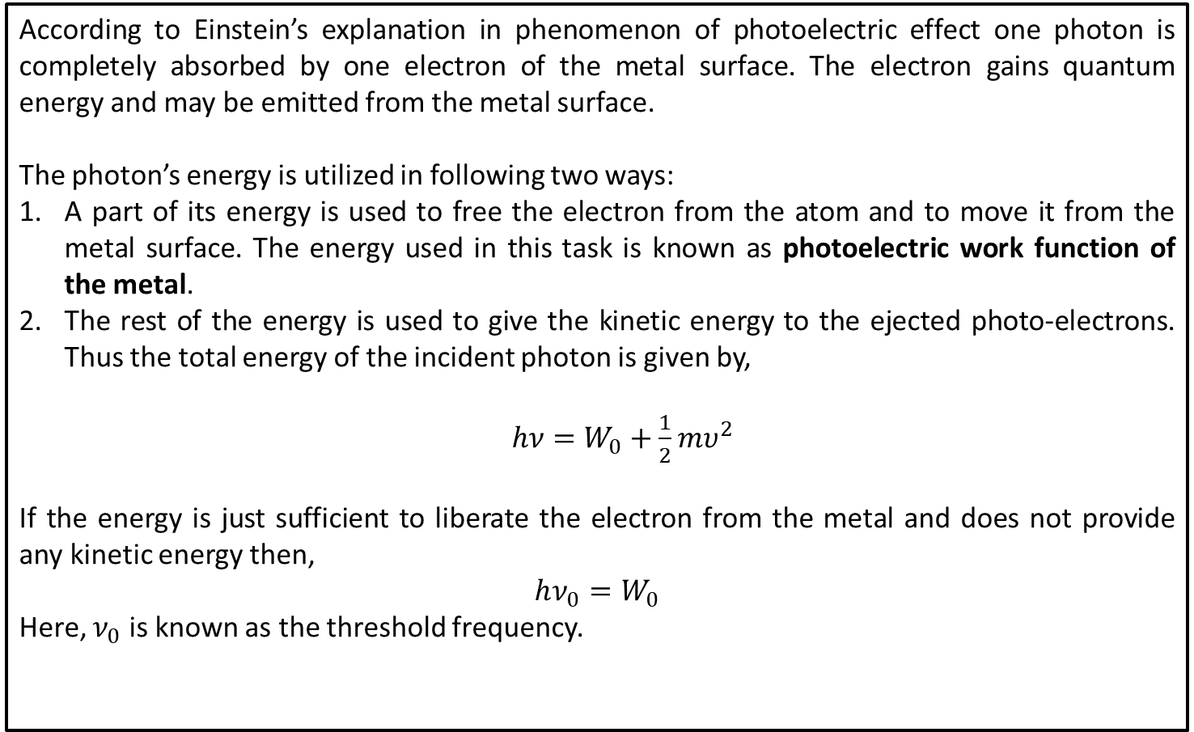
Einstein’s Photo-Electric Equation
According to Einstein’s explanation in phenomenon of photoelectric effect one photon is completely absorbed by one electron of the metal surface. The electron gains quantum energy and may be emitted from the metal surface.
The photon’s energy is utilized in following two ways:
A part of its energy is used to free the electron from the atom and to move it from the metal surface. The energy used in this task is known as photoelectric work function of the metal.
The rest of the energy is used to give the kinetic energy to the ejected photo-electrons. Thus the total energy of the incident photon is given by,
$hν=W_{0}+\frac{1}{2}mυ^{2}$
If the energy is just sufficient to liberate the electron from the metal and does not provide any kinetic energy then,
$$hν_{0}=W_{0}$$
Here, $ν_{0}$ is known as the threshold frequency.

Slide 12
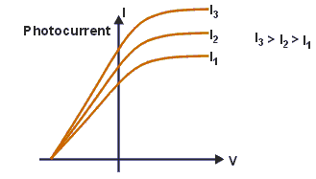

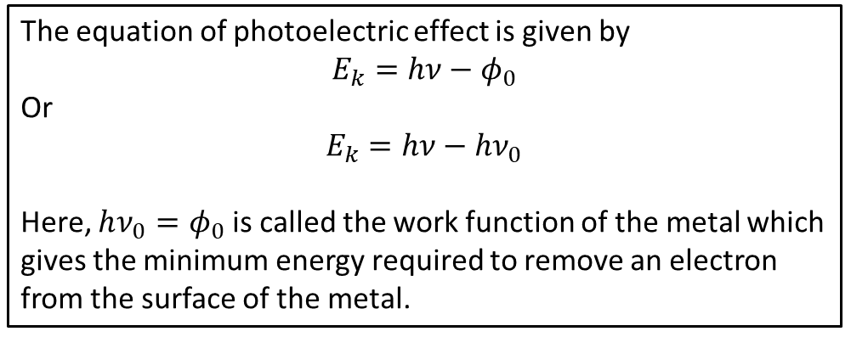
Photo-Electric Effect
The equation of photoelectric effect is given by
$$E_{k}=hν−φ_{0}$$
Or
$$E_{k}=hν−hν_{0}$$
Here, $hν_{0}=φ_{0}$ is called the work function of the metal which gives the minimum energy required to remove an electron from the surface of the metal.
The relation between current and applied voltage illustrates the nature of the photoelectric effect. For discussion, a light source illuminates a plate P, and another plate electrode Q collects any emitted electrons. We vary the potential between P and Q and measure the current flowing in the external circuit between the two plates.
If the frequency and the intensity of the incident radiation are fixed, the photoelectric current increases gradually with an increase in the positive potential on the collector electrode until all the photoelectrons emitted are collected. The photoelectric current attains a saturation value and does not increase further for any increase in the positive potential. The saturation current increases with the increase of the light intensity. It also increases with greater frequencies due to a greater probability of electron emission when collisions happen with higher energy photons.
KE
Slope=h
Frequency
Threshold
Frequency
$$−φ$$

Slide 13
Photo-Electric Effect
Work function of elements (eV)
Ag | 4.26 – 4.74 | Al | 4.06 – 4.26 | As | 3.75
Au | 5.10 – 5.47 | B | ~4.45 | Ba | 2.52 – 2.70
Be | 4.98 | Bi | 4.31 | C | ~5
Ca | 2.87 | Cd | 4.08 | Ce | 2.9
Co | 5 | Cr | 4.5 | Cs | 1.95
Cu | 4.53 – 5.10 | Eu | 2.5 | Fe: | 4.67 – 4.81
Ga | 4.32 | Gd | 2.90 | Hf | 3.90
Hg | 4.475 | In | 4.09 | Ir | 5.00 – 5.67
K | 2.29 | La | 3.5 | Li | 2.9
Lu | ~3.3 | Mg | 3.66 | Mn | 4.1
Mo | 4.36 – 4.95 | Na | 2.36 | Nb | 3.95 – 4.87
Nd | 3.2 | Ni | 5.04 – 5.35 | Os | 5.93
Pb | 4.25 | Pd | 5.22 – 5.60 | Pt | 5.12 – 5.93
Rb | 2.261 | Re | 4.72 | Rh | 4.98
Ru | 4.71 | Sb | 4.55 – 4.70 | Sc | 3.5
Se | 5.9 | Si | 4.60 – 4.85 | Sm | 2.7
Sn | 4.42 | Sr | ~2.59 | Ta | 4.00 – 4.80
Tb | 3.00 | Te | 4.95 | Th | 3.4
Ti | 4.33 | Tl | ~3.84 | U | 3.63 – 3.90
V | 4.3 | W | 4.32 – 5.22 | Y | 3.1
Yb | 2.60^{[13]} | Zn | 3.63 – 4.9 | Zr | 4.05
https://en.wikipedia.org/wiki/Work_function

Slide 14
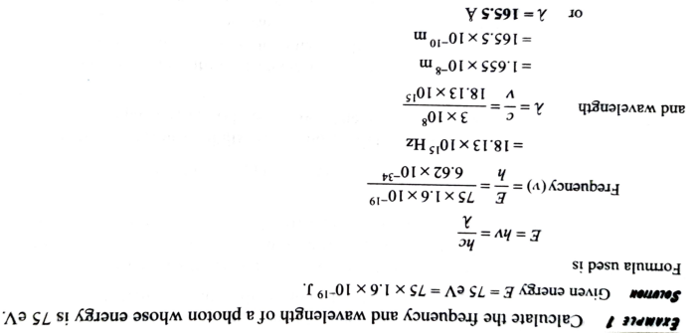
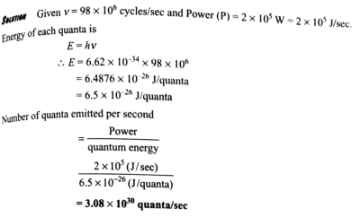
Problems on Photoelectric effect

Slide 15
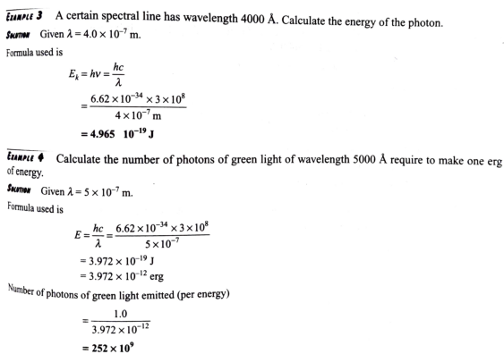
Problems on Photoelectric effect

Slide 16
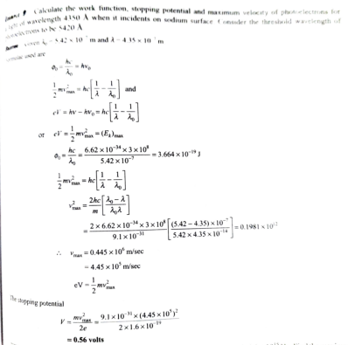

Slide 17
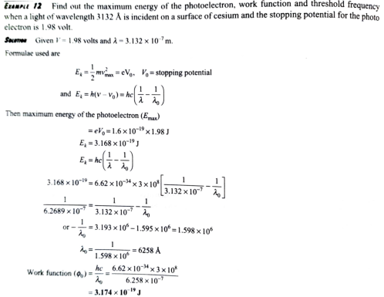

Slide 18
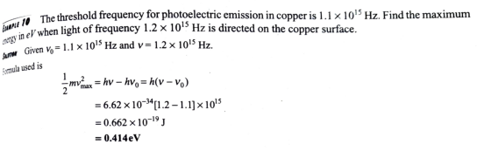
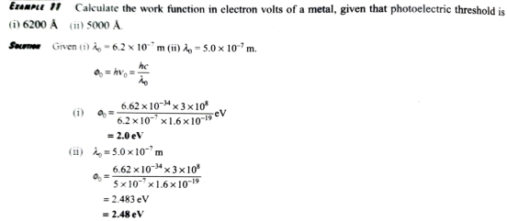

Slide 19
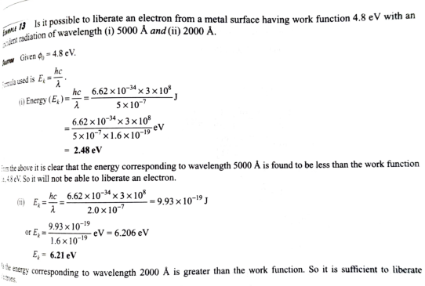

Slide 20
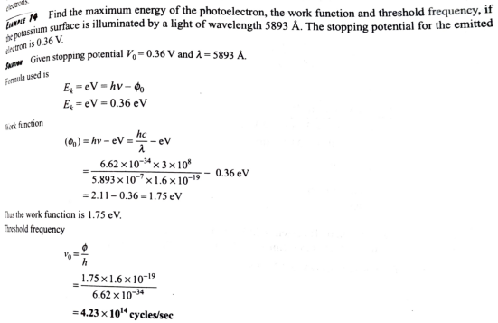

Slide 21
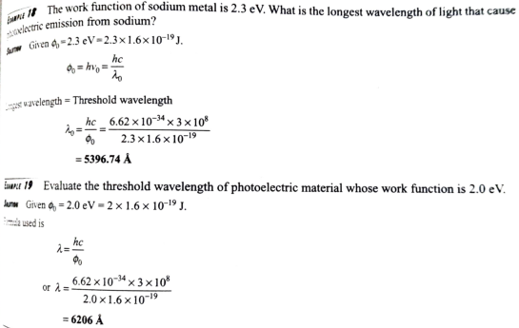

Slide 22
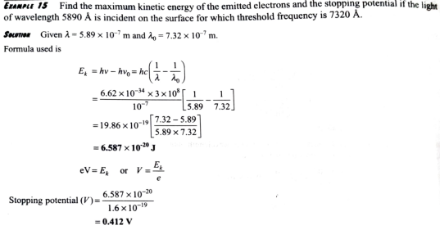

Slide 23
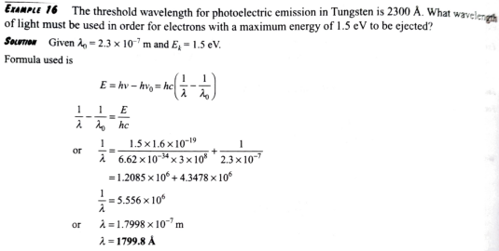

Slide 24

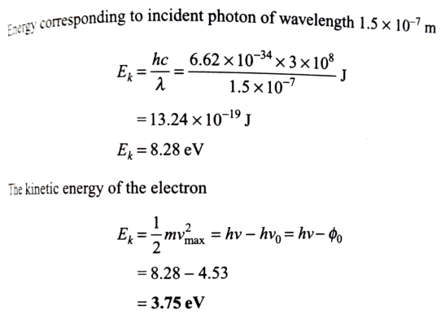

Slide 25
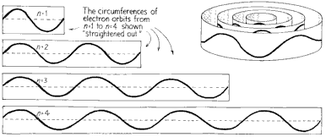
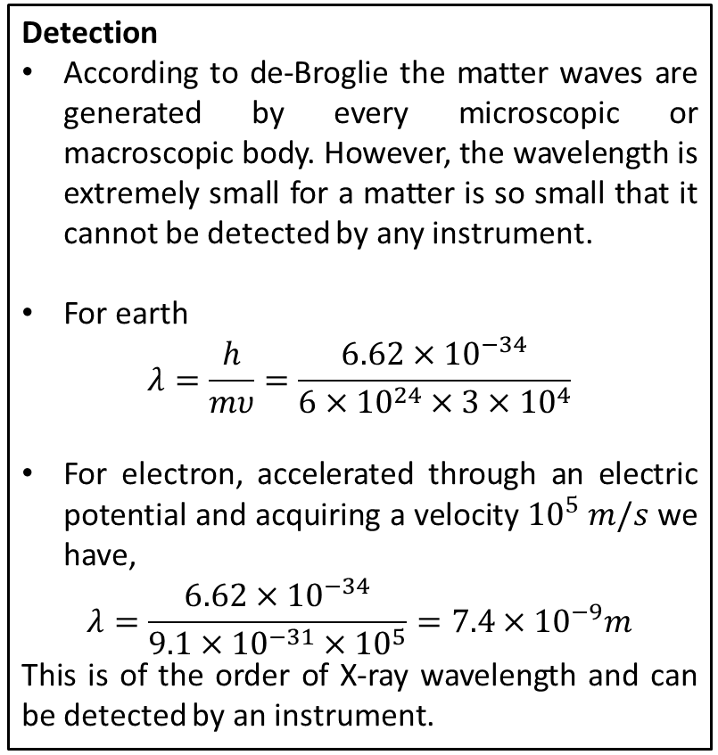
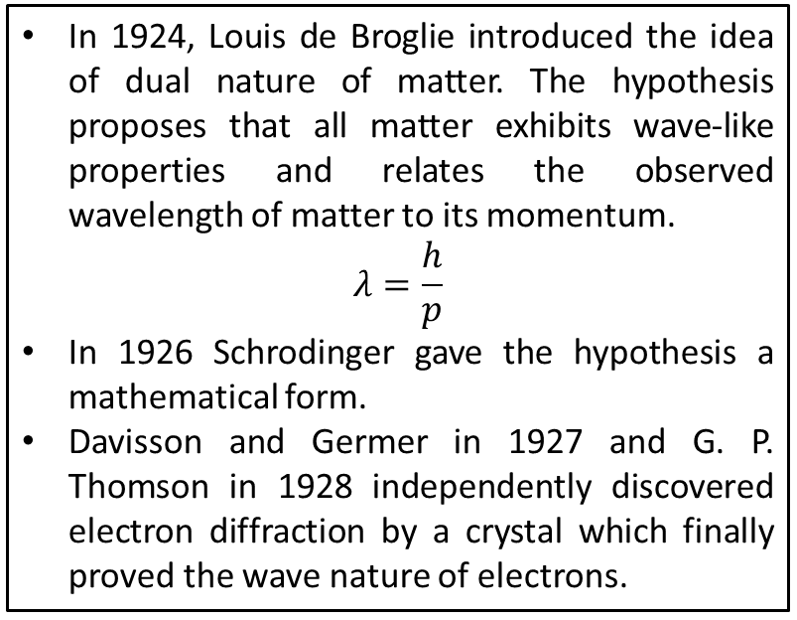
Dual Nature of Matter: de-Broglie Hypothesis
In 1924, Louis de Broglie introduced the idea of dual nature of matter. The hypothesis proposes that all matter exhibits wave-like properties and relates the observed wavelength of matter to its momentum.
$$λ=\frac{h}{p}$$
In 1926 Schrodinger gave the hypothesis a mathematical form.
Davisson and Germer in 1927 and G. P. Thomson in 1928 independently discovered electron diffraction by a crystal which finally proved the wave nature of electrons.
Detection
According to de-Broglie the matter waves are generated by every microscopic or macroscopic body. However, the wavelength is extremely small for a matter is so small that it cannot be detected by any instrument.
For earth
$$λ=\frac{h}{mυ}=\frac{6.62×{10}^{−34}}{6×{10}^{24}×3×{10}^{4}}$$
For electron, accelerated through an electric potential and acquiring a velocity ${10}^{5} m/s$ we have,
$$λ=\frac{6.62×{10}^{−34}}{9.1×{10}^{−31}×{10}^{5}}=7.4×{10}^{−9}m$$
This is of the order of X-ray wavelength and can be detected by an instrument.

Slide 26
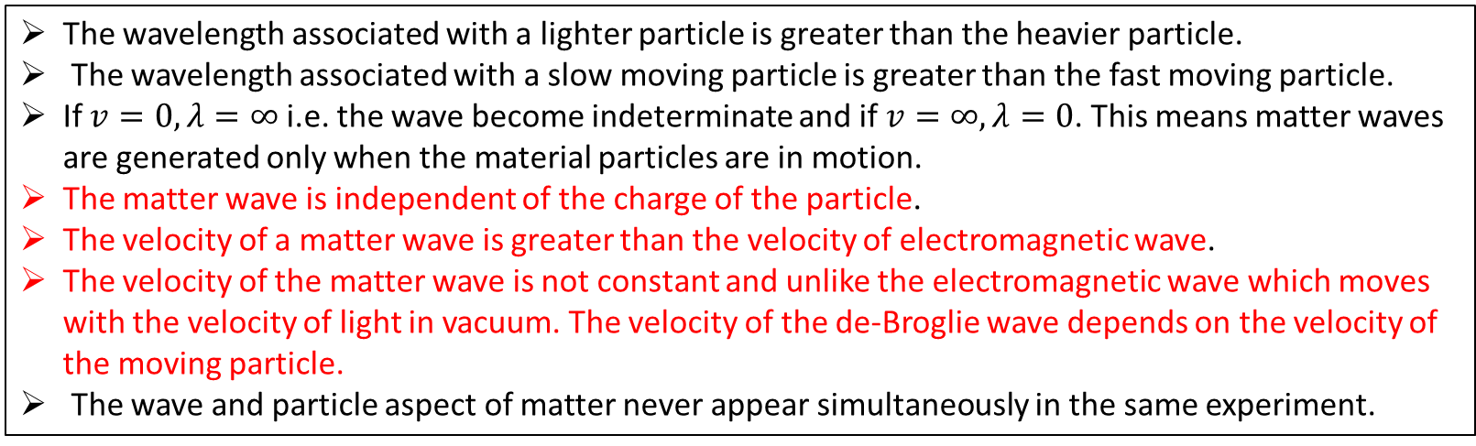
Properties of Matter waves
The wavelength associated with a lighter particle is greater than the heavier particle.
The wavelength associated with a slow moving particle is greater than the fast moving particle.
If $v=0, λ=∞$ i.e. the wave become indeterminate and if $v=∞, λ=0$. This means matter waves are generated only when the material particles are in motion.
The matter wave is independent of the charge of the particle.
The velocity of a matter wave is greater than the velocity of electromagnetic wave.
The velocity of the matter wave is not constant and unlike the electromagnetic wave which moves with the velocity of light in vacuum. The velocity of the de-Broglie wave depends on the velocity of the moving particle.
The wave and particle aspect of matter never appear simultaneously in the same experiment.
The red marked points confirms that de-Broglie waves are not electromagnetic waves.

Slide 27
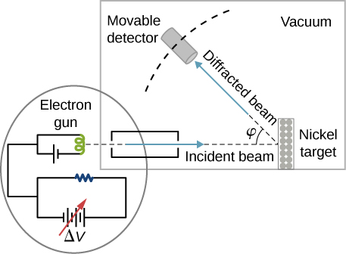
Davisson-Germer Experiment
The Davisson-Germer experiment demonstrated the wave nature of the electron, confirming the earlier hypothesis of de-Broglie. Putting wave-particle duality on a firm experimental footing, it represented a major step forward in the development of quantum mechanics. The Bragg law for diffraction had been applied to x-ray diffraction, but this was the first application to particle waves.
Davisson and Germer designed and built a vacuum apparatus for the purpose of measuring the energies of electrons scattered from a metal surface. Electrons from a heated filament were accelerated by a voltage and allowed to strike the surface of nickel metal.
The electron beam was directed at the nickel target, which could be rotated to observe angular dependence of the scattered electrons. Their electron detector (called a Faraday box) was mounted on an arc so that it could be rotated to observe electrons at different angles. It was a great surprise to them to find that at certain angles there was a peak in the intensity of the scattered electron beam. This peak indicated wave behavior for the electrons, and could be interpreted by the Bragg’s law to give values for the lattice spacing in the nickel crystal.
http://hyperphysics.phy-astr.gsu.edu/hbase/quantum/DavGer2.html

Slide 28
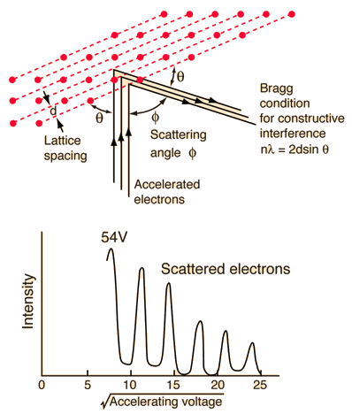
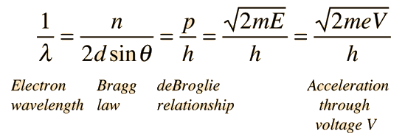


Davisson-Germer Experiment
The experimental data above, reproduced above Davisson's article, shows repeated peaks of scattered electron intensity with increasing accelerating voltage. This data was collected at a fixed scattering angle. Using the Bragg law, the de-Broglie wavelength expression, and the kinetic energy of the accelerated electrons gives the relationship
In the historical data, an accelerating voltage of 54 volts gave a definite peak at a scattering angle of 50°. The angle theta in the Bragg law corresponding to that scattering angle is 65°, and for that angle the calculated lattice spacing is 0.091 nm. For that lattice spacing and scattering angle, the relationship for wavelength as a function of voltage is empirically
$$n=2d sinθ$$
Trying this relationship for n=1,2,3 gives values for the square root of voltage 7.36, 14.7 and 22, which appear to agree with the first, third and fifth peaks above

Slide 29
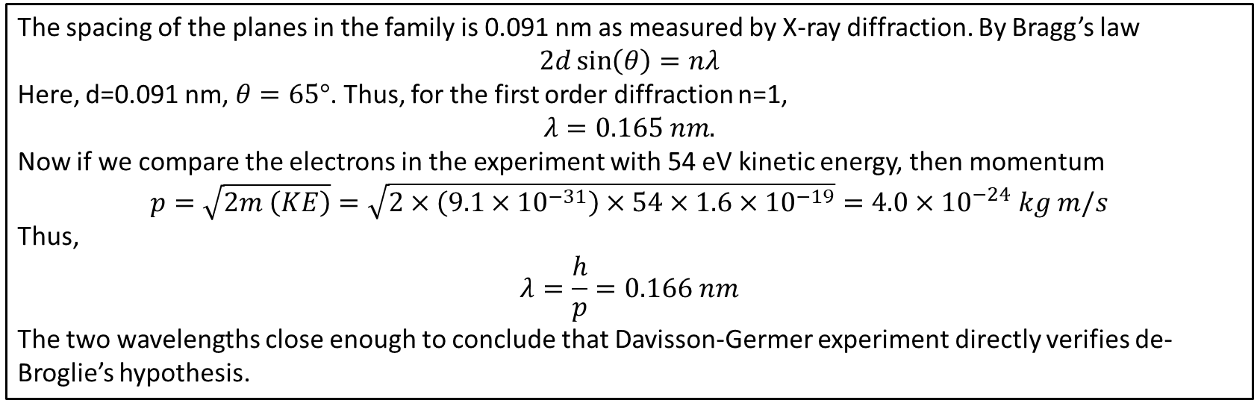
Davisson-Germer Experiment: Verification
The spacing of the planes in the family is 0.091 nm as measured by X-ray diffraction. By Bragg’s law
$$2d\sin\left(θ\right)=nλ$$
Here, d=0.091 nm, $θ=65°$. Thus, for the first order diffraction n=1,
$$λ=0.165 nm.$$
Now if we compare the electrons in the experiment with 54 eV kinetic energy, then momentum
$$p=\sqrt{2m \left(KE\right)}=\sqrt{2×\left(9.1×{10}^{−31}\right)×54×1.6×{10}^{−19}}=4.0×{10}^{−24} kg m/s$$
Thus,
$$λ=\frac{h}{p}=0.166 nm$$
The two wavelengths close enough to conclude that Davisson-Germer experiment directly verifies de-Broglie’s hypothesis.

Slide 30
Derivation of de Broglie wave or matter wave
Energy of photon of frequency ν is
$E=h\text{ν}$
If m is the mass of the photon corresponding to the energy E, then according to the Einstein’s mass energy relationship
$E=mc^{2}$
$E=h\text{ν}=mc^{2}$⇒ $m=\frac{h\text{ν}}{c^{2}}$
Momentum of the photon is $p=mc=\frac{h\text{ν}}{c^{2}}c=\frac{h\text{ν}}{C}=\frac{h}{λ}$
$=\frac{h}{p}$, where $$ is the wavelength of the light wave associated with a photon. ($KE=E=\frac{1}{2}mv^{2}=\frac{{(mv)}^{2}}{2m}=\frac{p^{2}}{2m}$
$=\frac{h}{p}=\frac{h}{mv}=\frac{h}{\sqrt{2mE}}=\frac{h}{\sqrt{2mqV}}p=\sqrt{2mE}$ and $E=qV$

Slide 31
Derivation of de Broglie wave or matter wave
For electron, accelerated through an electric potential V the wavelength of the wave associated to this electron is
$λ=\frac{h}{\sqrt{2meV}}=\frac{6.62×{10}^{−34}Js}{\sqrt{2×9.1×{10}^{−31}kg×1.6×{10}^{−19}C×V}}=\frac{1.23×{10}^{−11}}{\sqrt{V }}m$
$λ=\frac{12.3×{10}^{−10}}{\sqrt{V }}m=\frac{12.3}{\sqrt{V }}A^{°}$
Relation between momentum and propagation constant
$wavelength is λ=\frac{h}{p}$ and Propagation constant, $k=\frac{2π}{λ} or λ=\frac{2π}{k}$
$λ=\frac{h}{p}=\frac{2π}{k}$⇒ $p=\frac{hk}{2π}=ћk$

Slide 32
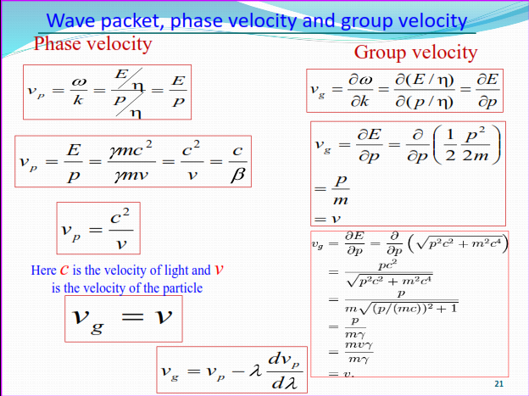

Slide 33
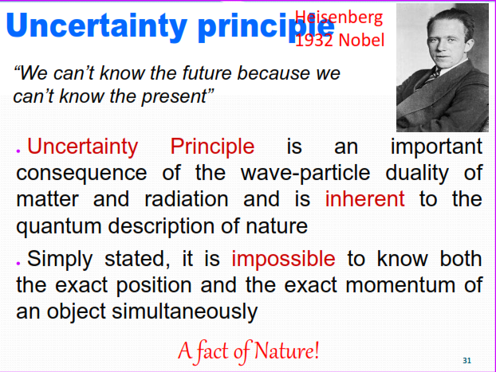

Slide 34
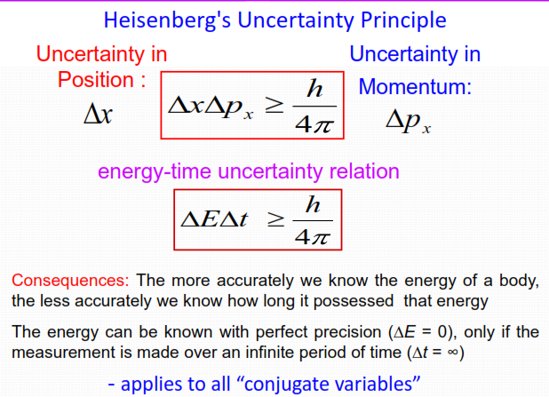

Slide 35
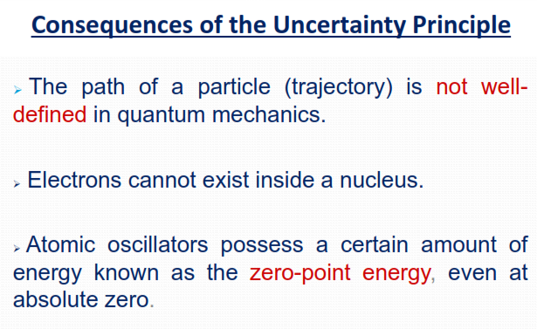

Slide 36
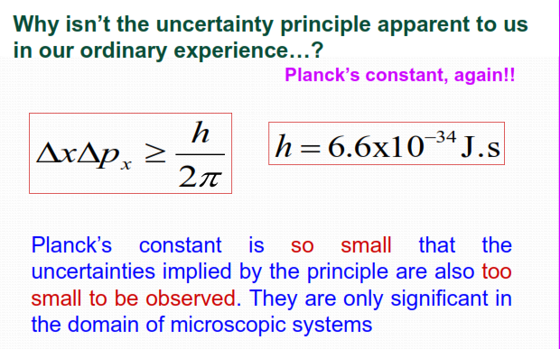

Slide 37
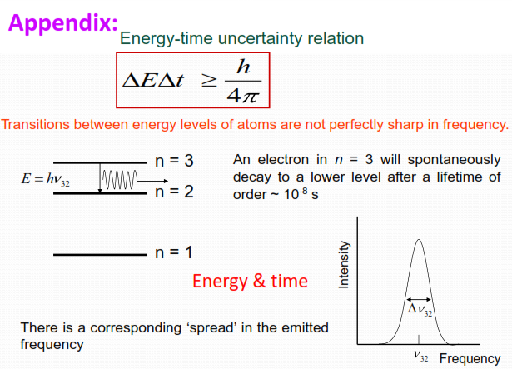

Slide 38
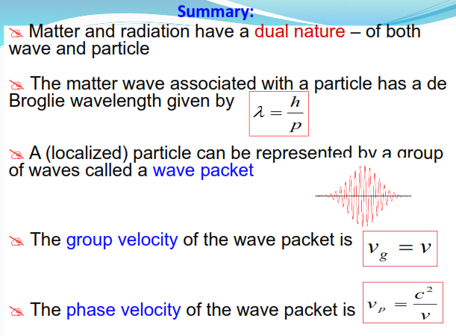

Slide 39
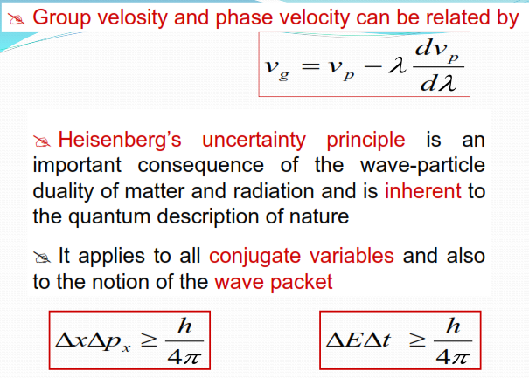

Slide 40
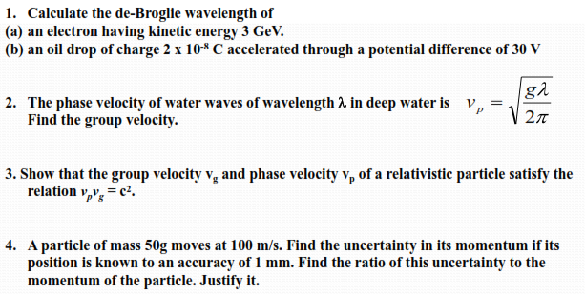

Slide 41
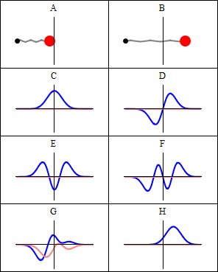
Wave functions
The analysis of electromagnetic wave, sound wave and other such waves shows that waves are characterized by certain definite properties.
In case of electromagnetic wave electric and magnetic field varies periodically whereas for sound waves pressure varies periodically.
Similarly for water waves height of the water surface
varies periodically.
Quantum mechanics is concerned with the variation of a quantity called the wave function. It is denoted by
𝜓 (𝑝𝑠𝑖).
Comparison of classical and quantum harmonic oscillator conceptions for a single spin-less particle. The two processes differ greatly. The classical process (A–B) is represented as the motion of a particle along a trajectory. The quantum process (C–H) has no such trajectory. Rather, it is represented as a wave; here, the vertical axis shows the real part (blue) and imaginary part (red) of the wave function. Panels (C–F) show four different standing- wave solutions of the Schrödinger equation. Panels (G–H) further show two different wave functions that are solutions of the Schrödinger equation but not standing waves
𝜓 itself has no physical interpretation. However, the
_{𝜓} 2
square of its absolute magnitude evaluated at a
particular place at a particular time is proportional to the probability of finding the body there at that time.

Slide 42
Well Behaved Wave functions
Wave functions with the following properties are known as the well behaved wave functions.
𝜓 must be continuous and single valued everywhere.
The derivatives of 𝜓 must be single valued and continuous everywhere.
𝜓 must be normalizable, which means that 𝜓 must go to 0 (zero) as 𝑥 → ±∞, 𝑦 →
± ∞ 𝑎𝑛𝑑 𝑧 → ±∞ in order that ׬ 𝜓 ²𝑑𝑉 over all space be a finite constant.

Slide 43
Probability
Wave function (Ψ): It is the quantity whose variations make up the matter waves. It is denoted by symbol (Ψ 𝒐𝒓 ). The wave functions are complex with both the real and imaginary parts.
As, 𝑇 = 𝐴 + 𝑖𝐵 => where A and B are real.
However, a probability must be a positive real quantity.
The probability density |𝝍 |^{𝟐} for a complex 𝝍 is therefore taken as the product 𝝍 ∗ 𝝍 (Here 𝜓 ∗ is the complex conjugate of 𝜓).
For a normalized and acceptable wave function 𝜓, the probability that the particle it describes will be found in a certain
region is simply the integral of the probability density |𝜓| ² over that region.
Thus, the probability of finding a particle between x₁ and x₂, moving in along x-axis is given by:
𝑥₂
_{𝜓} 2
^{𝑃}𝑥 ,𝑥
= න 𝑑𝑥
𝑥₁
1 2
If the particle is in three dimension then probability:
𝑟₂
𝑝 = න 𝑇 ²𝑑𝑥 𝑑𝑦𝑑𝑧
𝑟₁

Slide 44
Normalization and Orthogonality
Normalization: The probability that the particle will be found somewhere in the region is unity. This implies 𝑃 = 1 Or,
Which leads to a condition known as the condition of normalization. A wave function 𝜓
is said to be normalized if it satisfy the condition
∞
න
−∞
_{𝜓} 2
𝑑𝑥 = 1
Orthogonality: Two functions 𝜓and 𝜑 are said to orthogonal to each other if they satisfy the condition
∞
න 𝜑∗𝜓 𝑑𝑥 = 0
−∞
The above equation gives the condition of orthogonality.

Slide 45
Schrodinger Time dependent and Independent Form
The time dependent form of the Schrödinger equation depends on the physical situation. The most general form is the time- dependent Schrödinger equation, which gives a description of a system evolving with time.
The time-independent Schrödinger equation is the equation describing stationary states. The time-independent Schrödinger equation predicts that wave functions can form standing waves, called stationary states (also called "orbitals", as in atomic orbitals or molecular orbitals). These states are important in their own right, and if the stationary states are classified and understood, then it becomes easier to solve the time-dependent Schrödinger equation for any state.
https://www.quora.com/What-is-the-real-difference-between-the-time-dependent-Schrodingers-equation-and-time-independent-equation

Slide 46
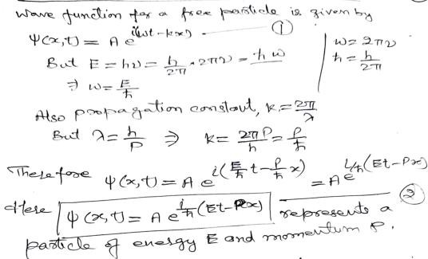
Schrodinger Equation

Slide 47
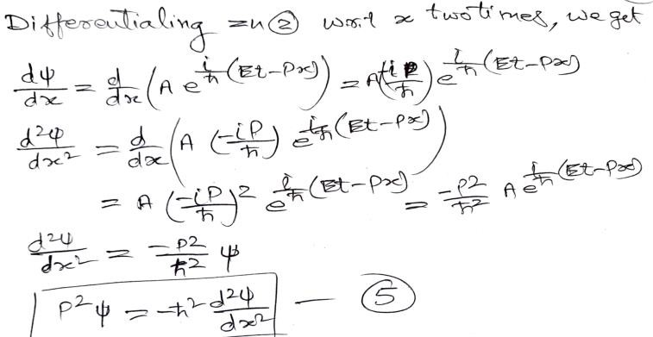
Schrodinger Equation
But the total energy of a particle of mass m acted upon by a force is the sum of kinetic and particle energy
1
_{𝑝}2
2
𝐸 = 𝑚𝑥 + 𝑉 𝑥
= + 𝑉 𝑥
2 2𝑚
Multiplying by 𝜓 from right side, we get
𝐸𝜓 =
1
𝑝²𝜓 + 𝑉 𝑥 𝜓
(3)
2𝑚

Slide 48
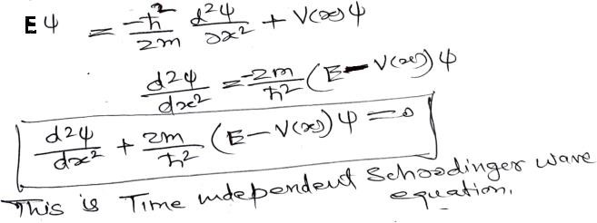
Time Independent Schrodinger Wave Equation
From equation (3) and (4) we get
For a particle moving in 3 dimensions:
𝜕²𝜓 𝜕²𝜓 𝜕²𝜓
𝜕𝑥² ⁺ 𝜕𝑦² ⁺ 𝜕𝑧²
2𝑚
+
_{ℏ}2
𝐸 − 𝑉 𝑥, 𝑦, 𝑧
𝜓 = 0
OR ❑²𝜓 + ^{2𝑚} 𝐸 − 𝑉 𝑥, 𝑦, 𝑧
_{ℏ}2
𝜓 = 0

Slide 49
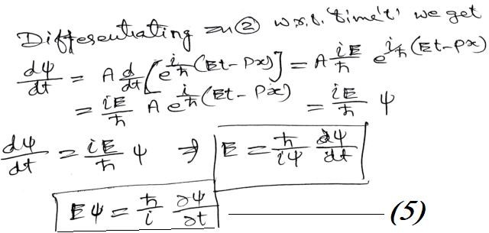
Time Dependent Schrodinger Wave Equation
From equation (3) and (5) we get
ℏ 𝜕Ψ ℏ² 𝜕²Ψ
= − + 𝑉 𝑥 Ψ
𝑖 𝜕𝑡 2𝑚 𝜕𝑥²
This is Time dependent Schrodinger wave equation.
For a particle moving in 3 dimensions, Time dependent Schrodinger wave equation may be written as
_{ℏ}2
𝜕²Ψ 𝜕²Ψ 𝜕²Ψ
𝜕Ψ
+ 𝑉 𝑥, 𝑦, 𝑧 Ψ = 𝑖ℏ
𝜕𝑡
− + +
2𝑚 𝜕𝑥² 𝜕𝑦² 𝜕𝑧²
OR
2
₋ ℏ
²Ψ + 𝑉 𝑥, 𝑦, 𝑧 Ψ = 𝑖ℏ ^{𝜕Ψ}
2𝑚
𝜕𝑡
April 29, 2023
PHY109 (ENGINEERING PHYSICS)
10

Slide 50
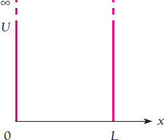
Particle in an infinite potential well (box)
The infinite potential well is defined as:
∞,
= ቐ 0,
∞
𝑥 < 0 0 ≤ 𝑥 ≤ 𝐿
𝑥 > 𝐿
Infinite potential well
𝑉 𝑥
Solving Schrodinger’s differential equation for V(x)=0 to obtain energy and wave function of the
particle trapped in the box, 0 ≤ 𝑥 ≤ 𝐿
𝜕²𝜓 2𝑚
+ 𝐸 − 𝑉 𝑥 𝜓 = 0
_{ℏ}2
𝜕𝑥²
𝜕²𝜓
𝜕𝑥² ⁺
2𝑚𝐸
_{ℏ}2
𝜓 = 0
The boundary conditions used to solve the Schrodinger’s equation are:
𝜓 𝑥 = 0
well.
April 29, 2023
= 0 and 𝜓 𝑥 = 𝐿 = 0 i. e. the wave function 𝜓 vanishes at the walls of the potential
PHY109 (ENGINEERING PHYSICS)
11

Slide 51
The wave function of the particle is for nth state is given by:
2 𝑛𝜋𝑥
𝜓 _{𝑛} = _{𝐿} 𝑠𝑖𝑛 _{𝐿}
The energy of the particle is for nth state is given by:
_{𝑛}2_{𝜋}2_{ℏ}2
𝐸_{𝑛} =
2𝑚𝐿²
The momentum of the particle is for nth state is given by:
𝑛𝜋ℏ
𝑝_{𝑛} =
𝐿
where n, m, L are quantum number, mass of the particle, length of the box.
The value of n is 1, 2, 3,…….
April 29, 2023
PHY109 (ENGINEERING PHYSICS)
12

